Slide 1
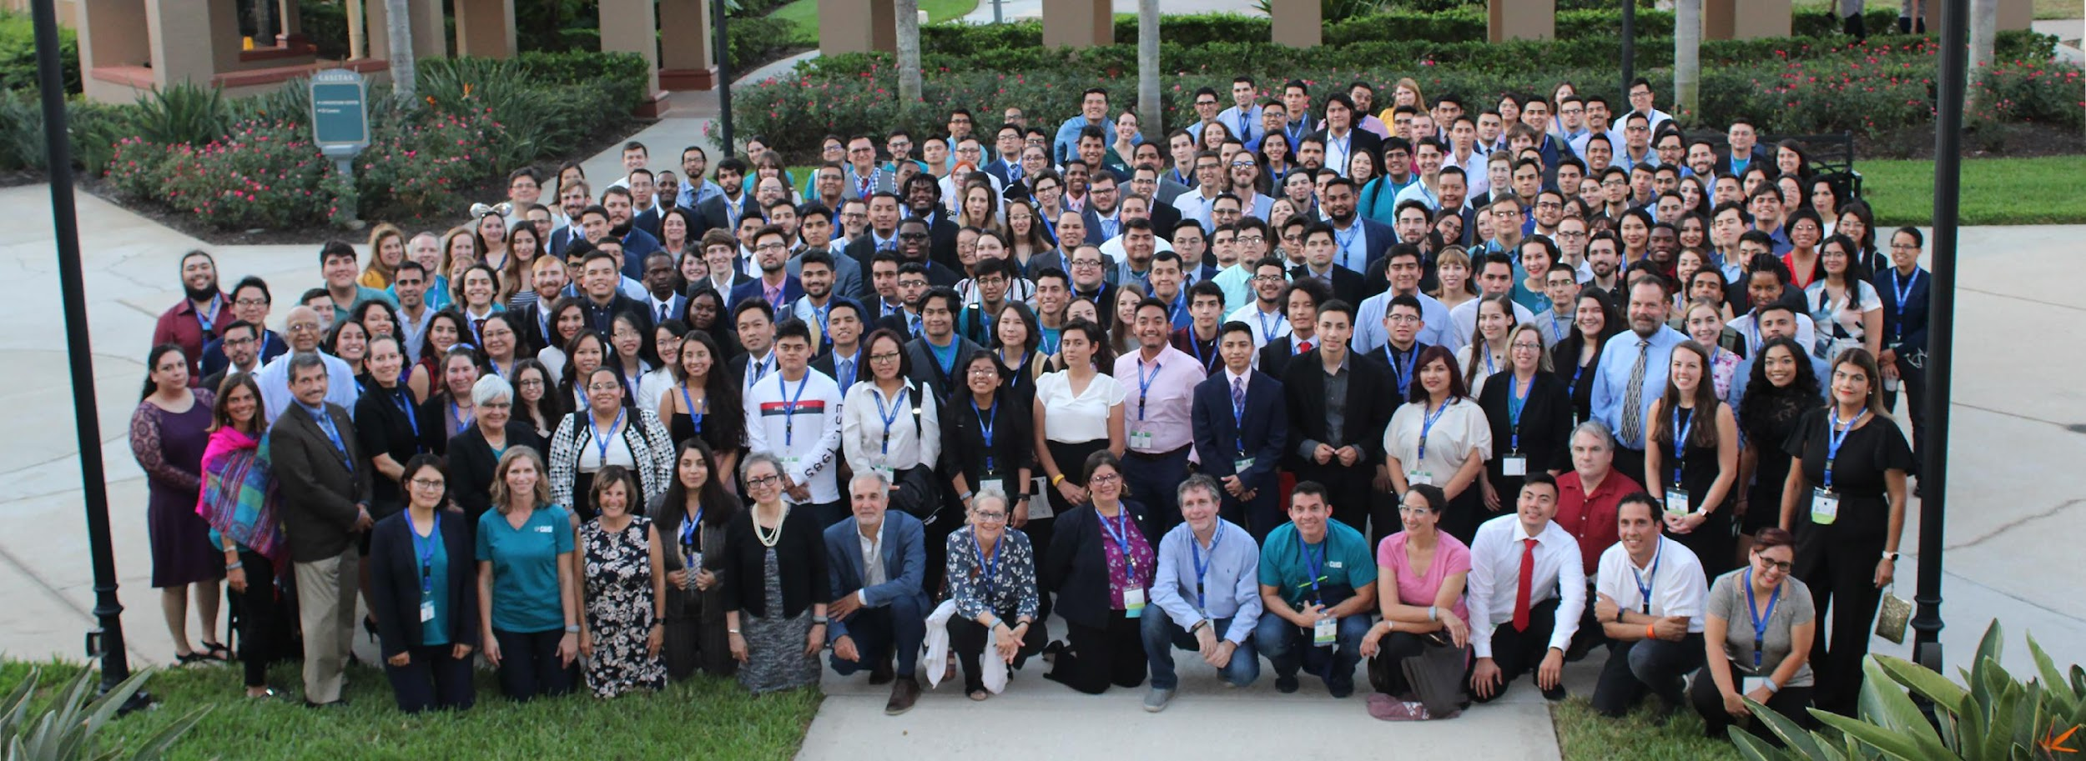



Slide 2

What is CAHSI?
CAHSI is a national alliance that was established in 2006 to address the low representation of Hispanics in computing in both higher education and the workforce. CAHSI works with 4-year and 2-year academic institutions, industry, non-profits, and government entities.
Mission
Grow and sustain a Networked Community committed to recruiting, retaining, and accelerating the progress of Hispanics in computing.
Vision
By 2030, Hispanics will represent 20% or more of those who earn credentials* in computing. *Credentials are defined as degrees and certifications that lead to gainful employment and advancement in the field.

Slide 3
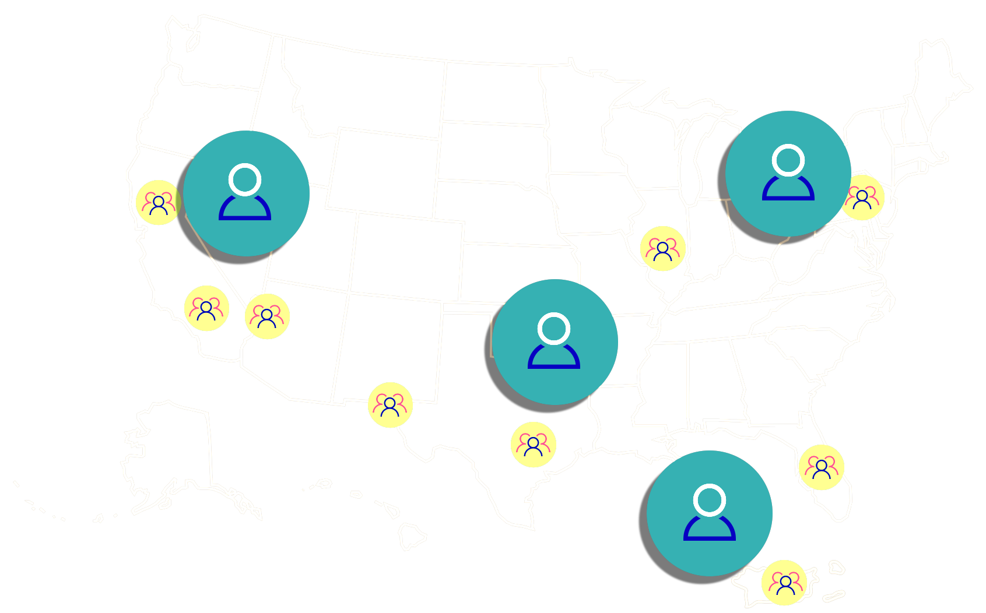

The CAHSI Alliance extends across 4 geographic regions.

Slide 4





Connect with CAHSI
@cahsialliance
cahsialliance@gmail.com
cahsi.org

Slide 5



CAHSI Data Analytics Challenge
Presentation by: Dr. Tuan Le (NMSU), Dr. Palvi Aggarwal (UTEP)
Team: Huiying Chen, Mohammad Ariful Islam Khan, Sanuj Kumar, Raena Cota, Dr. Tuan Le, Dr. Palvi Aggarwal, Dr. Huiping Cao, Dr. Enrico Pontelli, Dr. Ann Gates

Slide 6
Overview of Data Analytics
Objectives:
What, when, how should it happen?
What, when, how is the next-best action?
What is the impact?
Prescriptive Analytics
Objectives:
What, when, how, why could/will it happen?
Foresight
Approaches:
Actionable Knowledge Recovery
Recommendation
Heuristic Testing
Simulation
Optimization
Predictive Analytics
Stage, depth, challenge, intelligence, and human involvement
Objectives:
What happened, when, how?
Why did it happen?
Insight
Approaches:
Statistical Analysis
Artificial Intelligence
Predictive Modeling
Machine Learning, Data Mining
Forecasting
Descriptive Analytics
Approaches:
Standard Report
Statistical Analysis
Hindsight
Level of advantage, optimization, value, decision power, and significance of output
5

Slide 7




Predictive Analytics: Examples
Will the patient’s outcome from surgery be positive?
Will the airfare go down?
Will the credit applicant turn out to be a fraudster?
5
Notes:
By predicting these things, it is possible to fortify healthcare, combat risk, conquer spam, toughen crime fighting, boost sales, and cut costs.

Slide 8
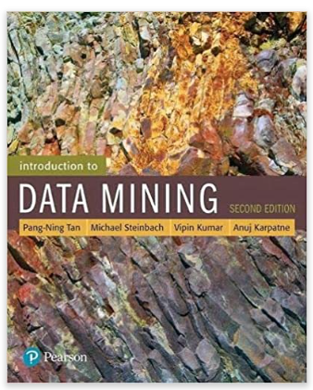


Book Recommendations - What Book to Read Next?
A user has read some books. Can we recommend what book he/she should read next?
He/She may also like
likes
Would he also give a 5 stars rating to this book?
This is a rating prediction problem
5

Slide 9
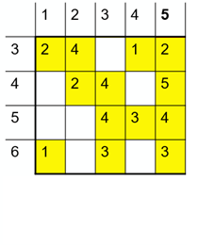
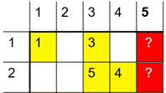

This Session: Predict Book Ratings
For simplicity, you are asked to predict ratings by a user uy in a dataset called D2
You are given a dataset called D1
users
users
books
books
Dataset D1
Dataset D2
<number>

Slide 10
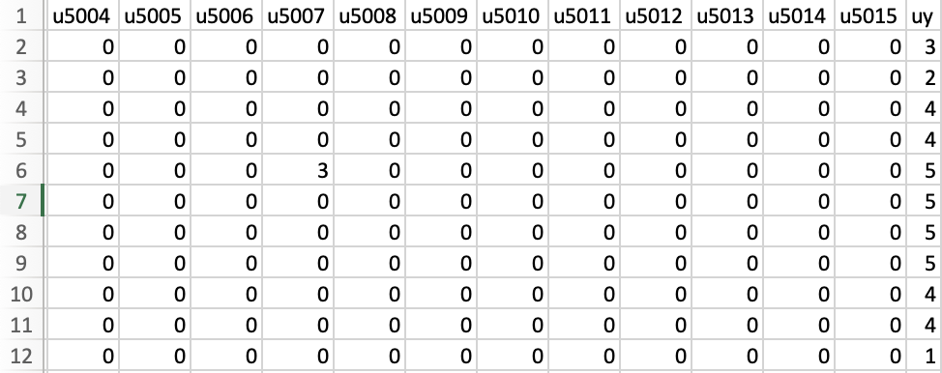
A Real Sample of Dataset D1
5017 users
(columns u0-u5015, uy)
1503 books (rows)
Rating between 1 to 5
0: unknown or missing rating
<number>

Slide 11
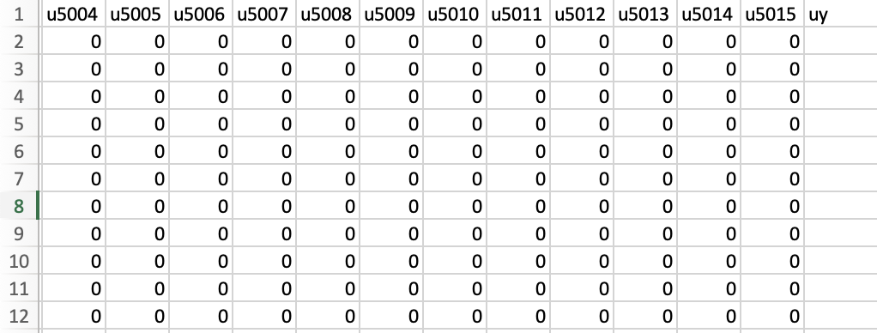
A Real Sample of Dataset D2
5017 users
(columns u0-u5015, uy)
?
?
?
376 books (rows)
?
?
?
?
?
?
?
?
Rating between 1 to 5
0: unknown or missing rating
<number>

Slide 12





A Simple Approach: Finding a Similar User
reads
likely will also
read that book
both like
<number>
This is an example of User-User Collaborative Filtering

Slide 13
Example
Dataset D1
Dataset D2
users
users
books
books
Users 3 and 5 are similar because they give similar ratings to books 4, 5, 6
The rating of book 1 by user 3 is 3
→ likely that user 5 also gives a rating 3 to book 1
<number>

Slide 14


Another Simple Approach: Finding a Similar Item
is rated by
is rated by
?
Likely 4 stars
<number>
This is an example of Item-Item Collaborative Filtering

Slide 15
Example
Dataset D1
Dataset D2
users
users
books
books
Books 5, 2 are similar because they are given similar ratings by users 3, 4. User 5 gives a rating 4 to book 5.
→ likely that user 5 also gives a rating 4 to book 2
<number>

Slide 16
Logistics
Competition duration
Starting: 8:30 am Pacific Standard Time (PST) Oct. 6, 2022
Ending: 11:30am PST Oct. 6, 2022
<number>
Notes:
3rd office hour:
Need Raena’s help to create breakout room for each team because the sponsor may want to chat with each team.

Slide 17
Get the data and submit your work
Get the data
http://www.cs.nmsu.edu/~hcao/competition/cahsi_data_2022.zip
Password will be provided once everybody gets the file
Submit your work
Through CAHSI Data Analytics Hackathon (the link is provided in later slides)
Detailed instructions will be explained in the following several slides.
<number>

Slide 18
Submit your work - prepare your answer
In D2.csv file, fill in the 376 rows of column uy.
Download a file http://www.cs.nmsu.edu/~hcao/competition/answer_eg.zip
Uncompress this file you will get answer.txt, from which you can understand how you will organize your submitted file
Submit this answer_eg.zip through the steps shown in the next few slides
If you updated your prediction later and want to submit it one more time: Please follow step 3.
Your answer file MUST still be named answer.txt (IMPORTANT).
IMPORTANT: you should only zip the answer.txt instead of a folder containing answer.txt
Your zip files MUST be a zip file (IMPORTANT). It can be named as answer_team1_attempt2.zip or answer_team2_attempt2.zip, etc.
<number>

Slide 19
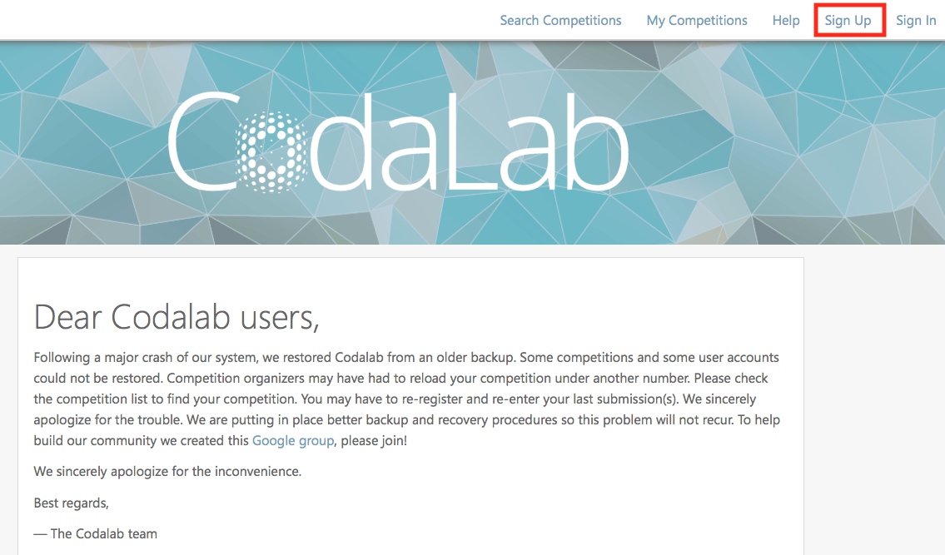
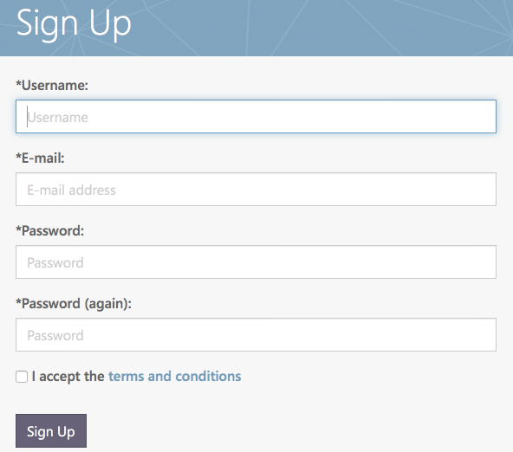
Submit your work - preparation - sign up
Go to http://codalab.lisn.fr and create an account for your team.
<number>

Slide 20
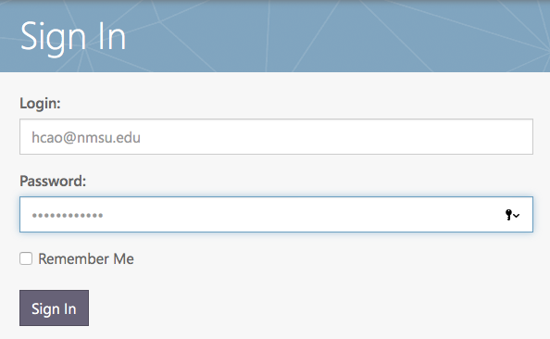
Submit your work - preparation - sign in
Go to http://codalab.lisn.fr and sign in.
<number>

Slide 21
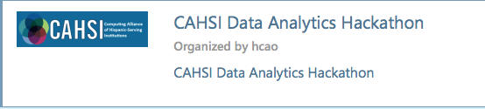
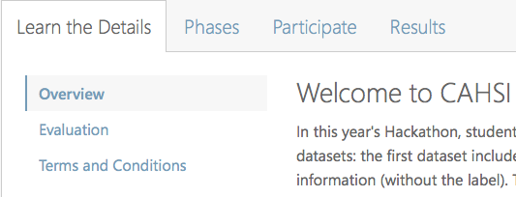
Submit your work - after you are approved to participate
In a browser, go to the competition (the link is provided at a later slide)
You will see an interface similar to this →
<number>

Slide 22
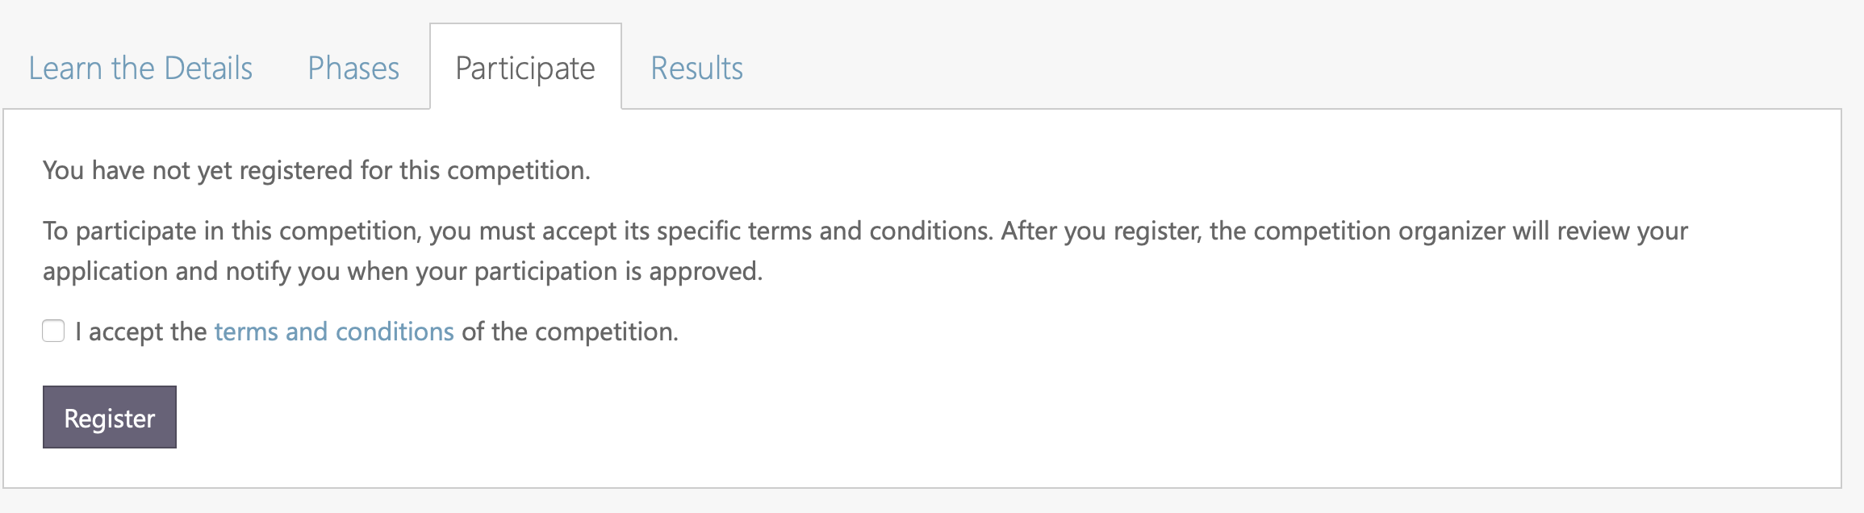
Step 4: Submit your work - participate
Click tab “Participate”, you will see an interface showing similar to what follows.
Accept the terms and the conditions
Click the “Register” button
<number>

Slide 23
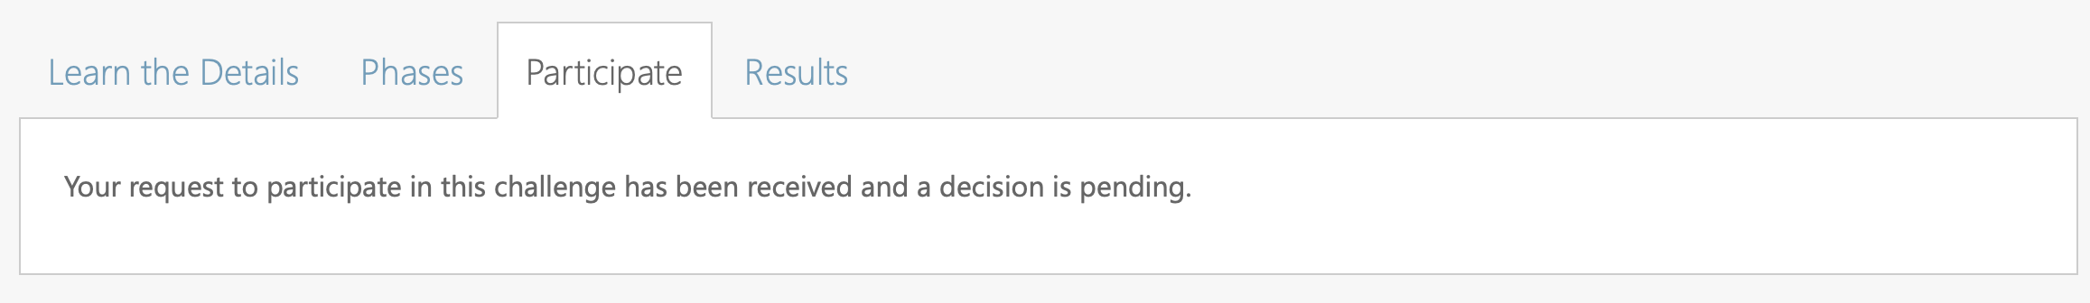
Step 4: Submit your work - participate
After you click your register button, you need to wait for us to approve your registration. You should see a message like this when your registration is pending.
<number>

Slide 24
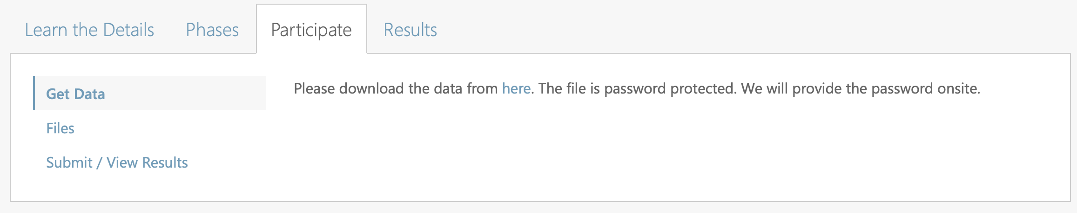
Step 4: Submit your work - participate
After 2-3 seconds, refresh your browser. You should see an interface similar to what is shown below.
<number>

Slide 25
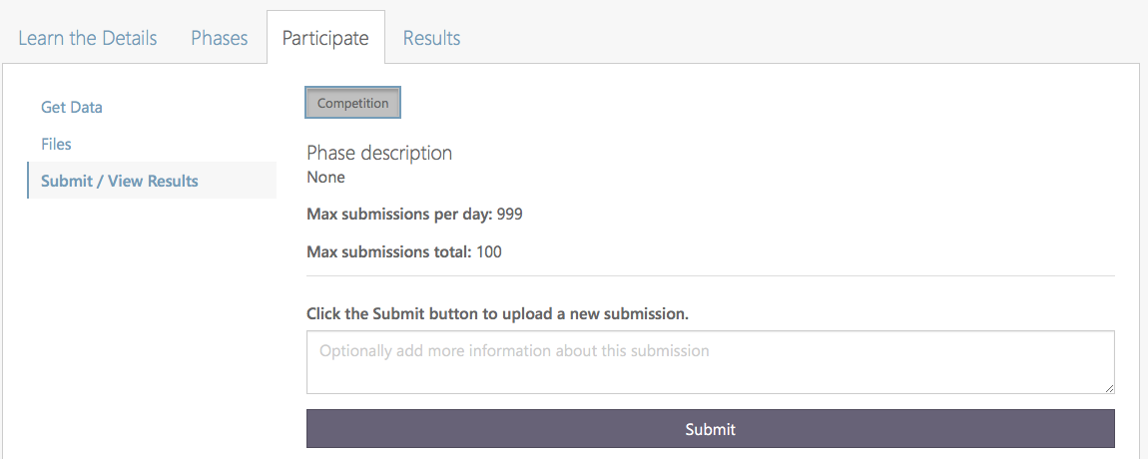
Step 4: Submit your work - participate
When you see the following interface, find and click “Submit/View Results” from the left panel.
<number>

Slide 26
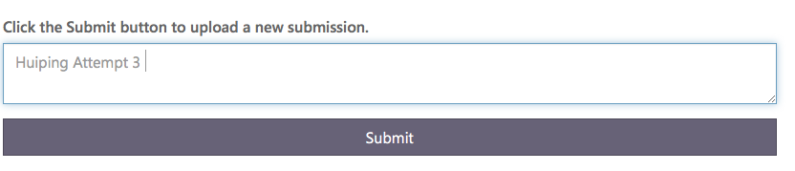
Step 4: Submit your work - participate
Put basic description about your submission in the box.
Then, click the “Submit” button.
After you click the Submit button, the system will prompt you to upload your answer file. Choose your answer_teamx_attempty.zip.
<number>

Slide 27
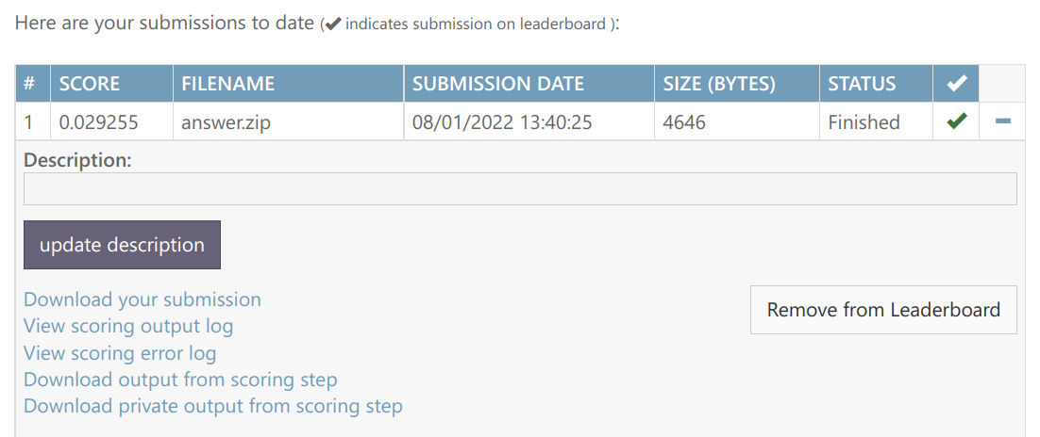
Step 4: Submit your work - participate
Now the dashboard should show your submitted files, submission dates, and status. Your recent submission status should be “Submitting”.
<number>

Slide 28
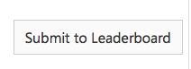
Step 4: Submit your work - participate
Click the “Refresh status” button, your status will be changed to “Running” or “Finished”.
Once the status changes to “Finished”, the “Refresh status” button will change to “Submit to Leaderboard”. Click this button, your results should be uploaded to the system.
<number>

Slide 29
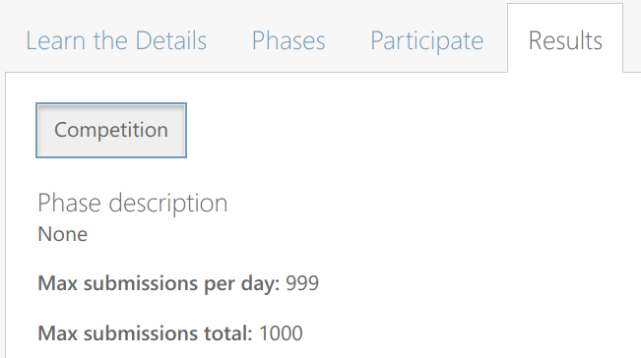
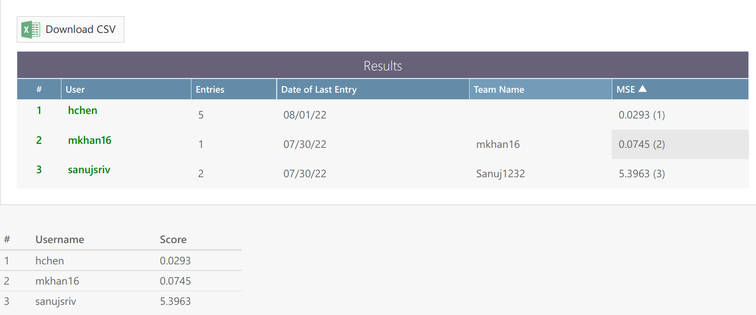
Step 4: Submit your work - participate - show results
Click the “Results” tab, you should be able to see your best result and your rank.
The maximum number of submissions is 1000. Do not submit more than 1000 times!
<number>

Slide 30
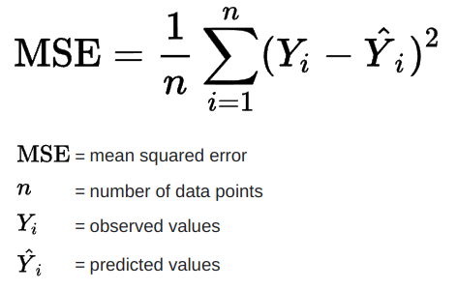
Result - MSE Score
The mean squared error (MSE) measures the average squared difference between the predicted values and the actual value.
<number>

Slide 31
A possible error when submitting your answer
If your answer.txt is not zipped or is not zipped correctly, the competition site may give you an error message.
After seeing the error message, the “submit” button is greyed out.
You can only submit again after refreshing the page (or clicking on the submit/view results tab again).
<number>

Slide 32
Prizes & Team formation
Prizes
1st: $200 per team
2nd: $150 per team
3rd: $100 per team
Team formation
With 1-3 people, i.e., you can form a team (1) with only yourself, or (2) with yourself and one more person, or (3) with yourself and two more people
Please create a TEAM name
Submit your team formation through this form (https://forms.gle/gx4eQwqTdTwaTZKn6)
<number>

Slide 33
The first step - go through the submission
Set up a competition account for your team at http://codalab.lisn.fr
Register for the competition and get approval.
Competition link: https://bit.ly/GMiSDataAnalytics22
Download an example answer file http://www.cs.nmsu.edu/~hcao/competition/answer_eg.zip
Submit the example answer file to the competition system
Check results
Download the data file http://www.cs.nmsu.edu/~hcao/competition/cahsi_data_2022.zip
(please make sure you can get both D1 and D2 and understand them).
<number>

Slide 34
Submit your source code
Within half an hour after the competition is done, please submit your source code through https://forms.gle/5QArSSZNKJHSYnTS9
Please properly organize your source code and have a README file.
Your README file needs to explain how to run your code.
We need to verify your solutions.
<number>

Slide 35
Print/share all the previous slides with students
<number>

Slide 36
Dataset password
CAHSI2022!
<number>

Slide 37
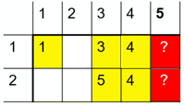
Hint 1: Finding multiple similar users
Dataset D1
Dataset D2
users
users
books
books
Users 3, 4 and 5 are similar because they give similar ratings to books 4, 5, 6
The ratings of book 1 by users 3, 4 are 3, 4 respectively
→ likely that user 5 will give a rating (3 + 4)/2 = 3.5 to book 1
Hint: Instead of finding one similar user, we can find multiple similar users and take the averaged ratings by those similar users
<number>

Slide 38
Hint 2: Finding multiple similar items
Dataset D1
Dataset D2
users
users
books
books
Items 4, 5 are similar to book 2 because they are given similar ratings by user 3. User 5 gives ratings 5, 4 to items 4, 5.
→ likely that user 5 will give a rating (4+5)/2 = 4.5 to book 2
Hint: Instead of finding one similar item, we can find multiple similar items and take the averaged ratings by uy
<number>

Slide 39
Hint 3: Use different models
Linear Regression (https://scikit-learn.org/stable/modules/generated/sklearn.linear_model.LinearRegression.html)
Non-linear Regression (https://scikit-learn.org/stable/modules/generated/sklearn.svm.SVR.html)
Latent Factor Models (https://surprise.readthedocs.io/en/stable/matrix_factorization.html#surprise.prediction_algorithms.matrix_factorization.SVD)
<number>

Slide 40
Backup submission plan
When the submission website is not available, please submit your results through https://forms.gle/CYnQUUtHzKEvZkB37
You are allowed to submit only three results (i.e., three answer.txt files).
<number>

